Slide 1

Behavior Pattern:
Strategy Pattern
00

Slide 2

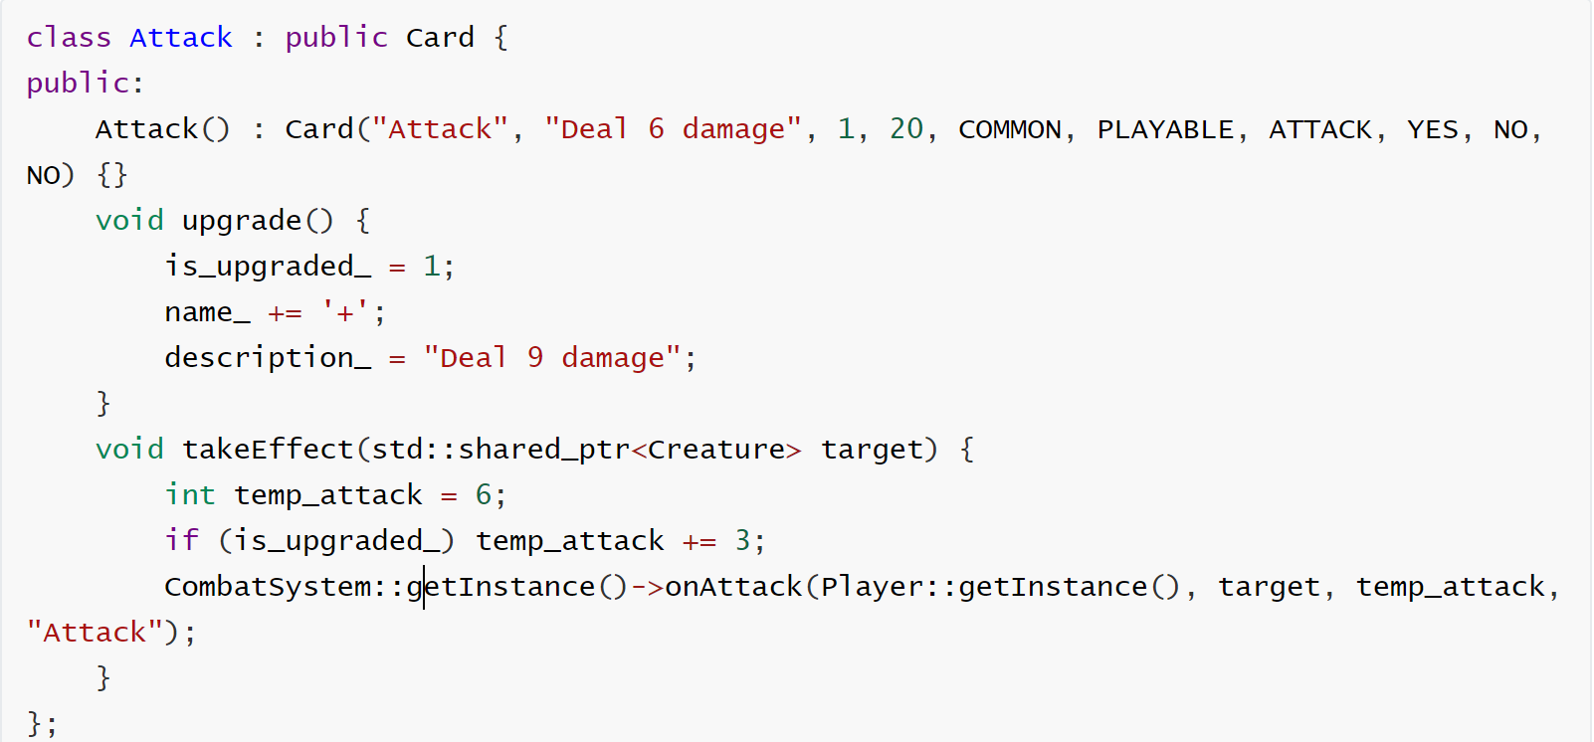
Behavior Pattern: Strategy Pattern
Card Strategy Refactoring
Before
Overview
The Card system refactor replaces hardcoded logic with interchangeable IEffect components to enable modular composition.
Issue Before Refactoring
1. Duplication: Damage, block and upgrade logic were repeated across many cards
2. Mixed Concerns: Gameplay rules, UI flow, and state flags were intertwined, and multi-phase flows were scattered across conditional branches instead of encapsulated behaviors.
3. Low Composability: Combining effects required bespoke code, common primitives couldn’t be cleanly reused.

Slide 3
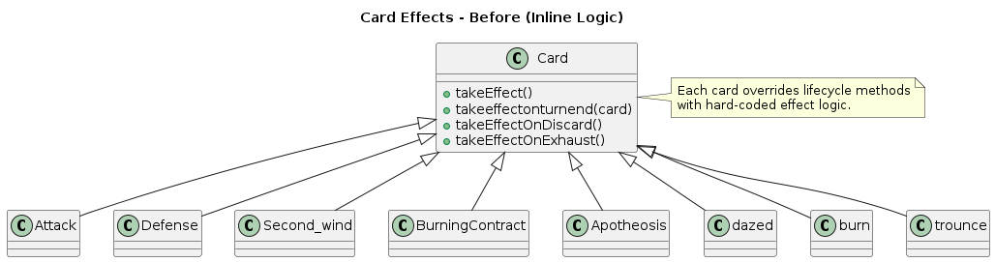
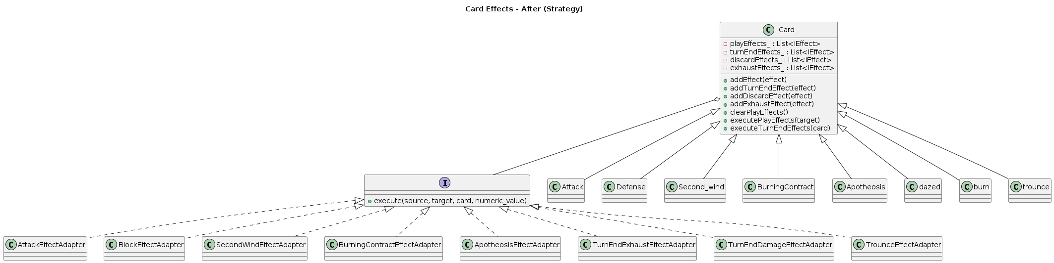
Behavior Pattern: Strategy Pattern
UML Changes
Before
Refactor Overview
1. Separation of Concerns: Card lifecycle hooks delegate execution to independent IEffect strategies instead of using hardcoded logic.
2. Modular Composition: Complex behaviors are implemented by assembling or swapping reusable IEffect components within the Card container.
After

Slide 4
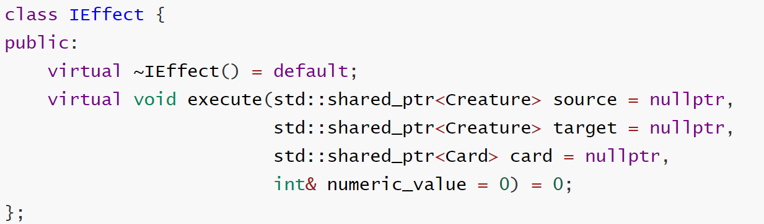
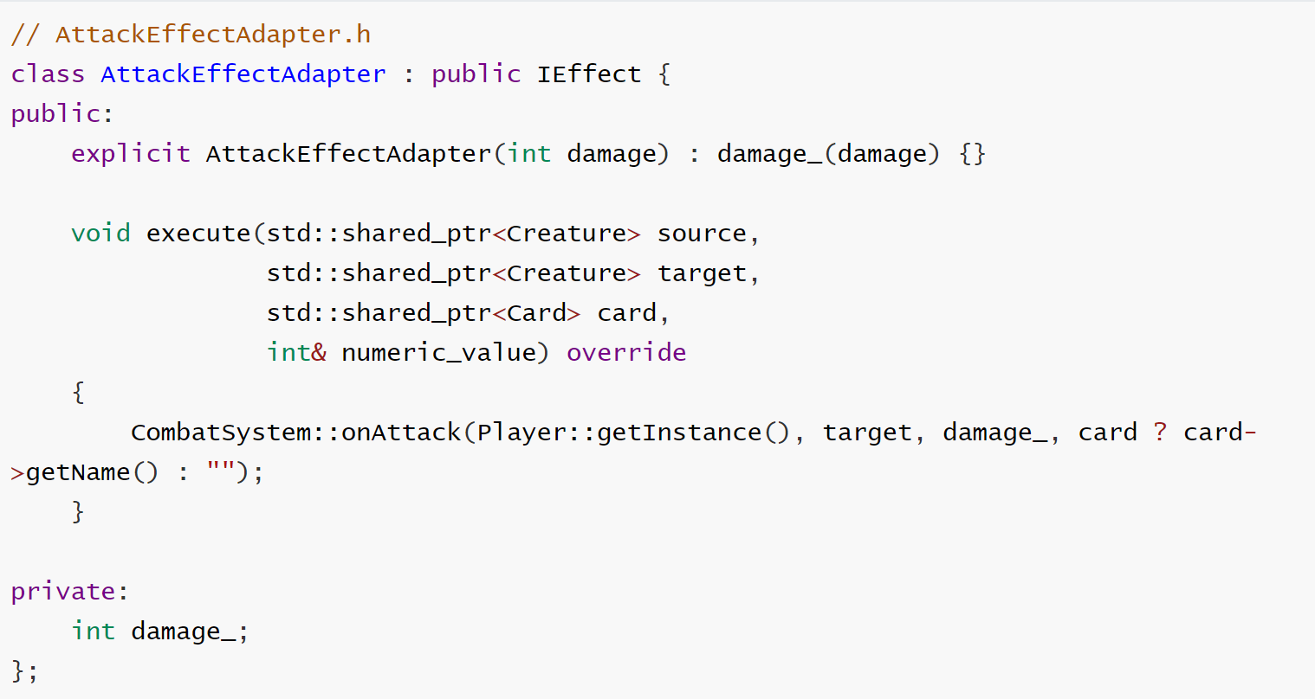
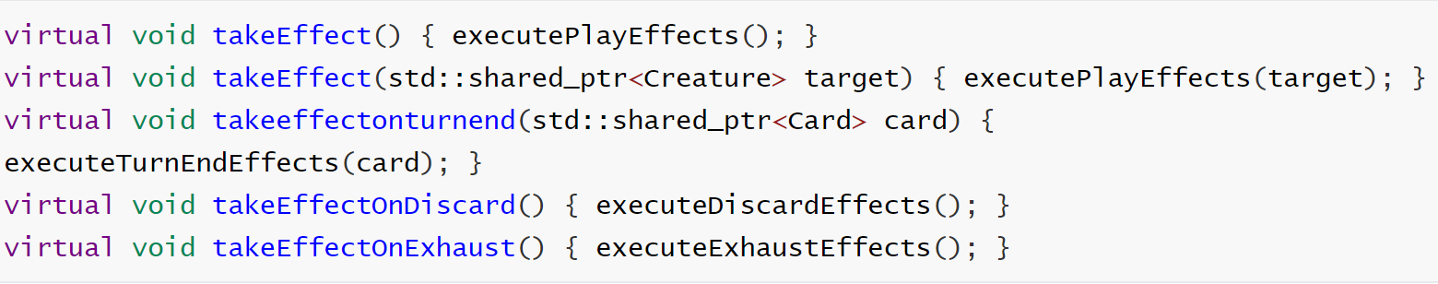
Behavior Pattern: Strategy Pattern
Detailed implementation
2. Implement concrete effect strategies
1. Define Strategy Interface and lifecycle hooks

Slide 5
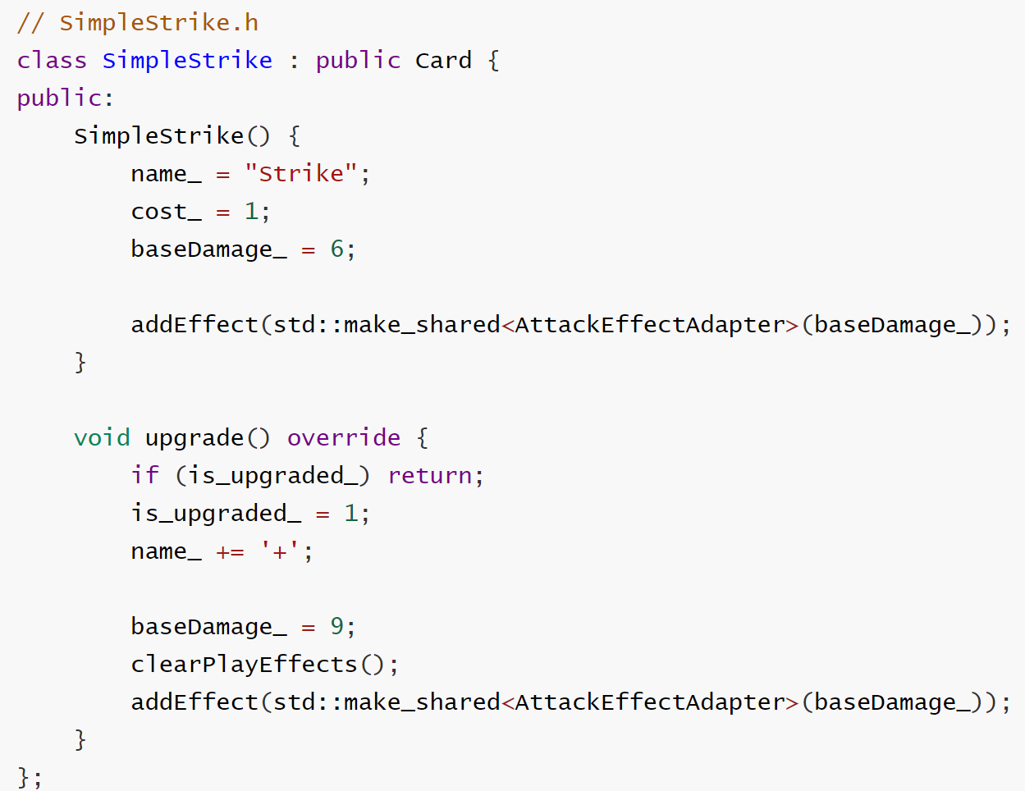
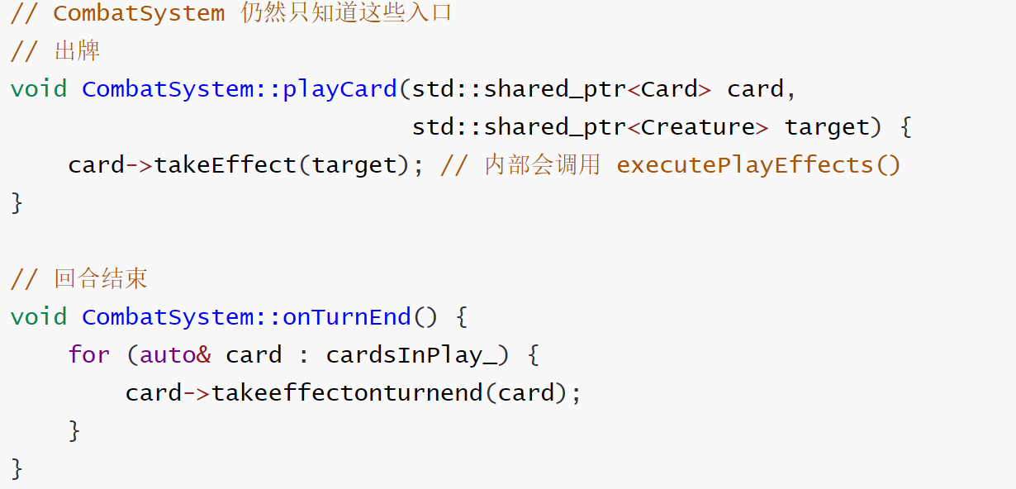
Behavior Pattern: Strategy Pattern
Detailed implementation
3. Compose cards from strategies
4. Keep engine integration

Slide 6
Behavior Pattern: Strategy Pattern
Advantages
1. Separation of Concerns：The definition of a card is cleanly separated from its execution logic. Card acts as a container, while IEffect classes handle specific gameplay mechanics.
2. Code Reusability: With reusable IEffect classes like AttackEffectAdapter, core mechanics are implemented once and shared across all cards, eliminating code duplication and ensuring consistency.
3. Runtime Flexibility: Behaviors can be modified dynamically at runtime. Upgrading a card becomes a matter of swapping strategy objects in a list rather than evaluating complex conditional flags.
4. Enhanced Testability: By isolating behaviors into distinct strategy classes, specific mechanics can be unit-tested independently without instantiating the full Card or CombatSystem context.
Limitations
Increased Class Explosion：Implementing the Strategy Pattern results in a larger number of classes, as each unique behavior type requires its own concrete IEffect implementation.
Communication Overhead： Strategies require explicit context passing. The execute method signatures can become bloated if strategies need access to deep system states that are not passed in by default.

